Slide 1
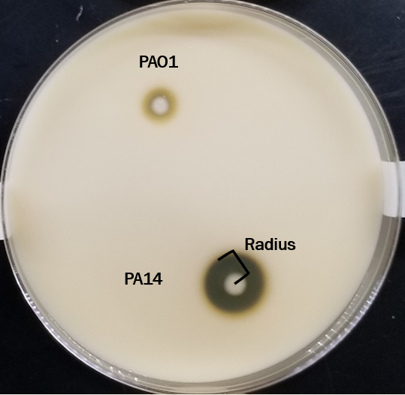
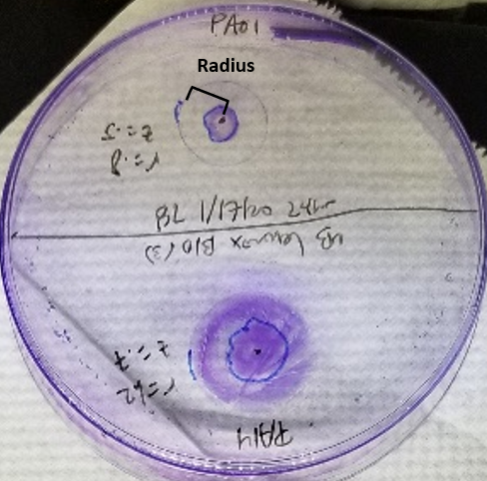
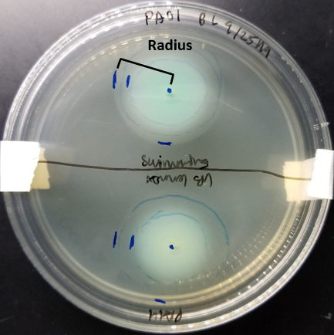
The impact of Staphylococcus aureus volatiles on Pseudomonas aeruginosa phenotypes
Brianna Lopez
Dr. Heather Bean Laboratory
Notes:
Assay pictures

Slide 2
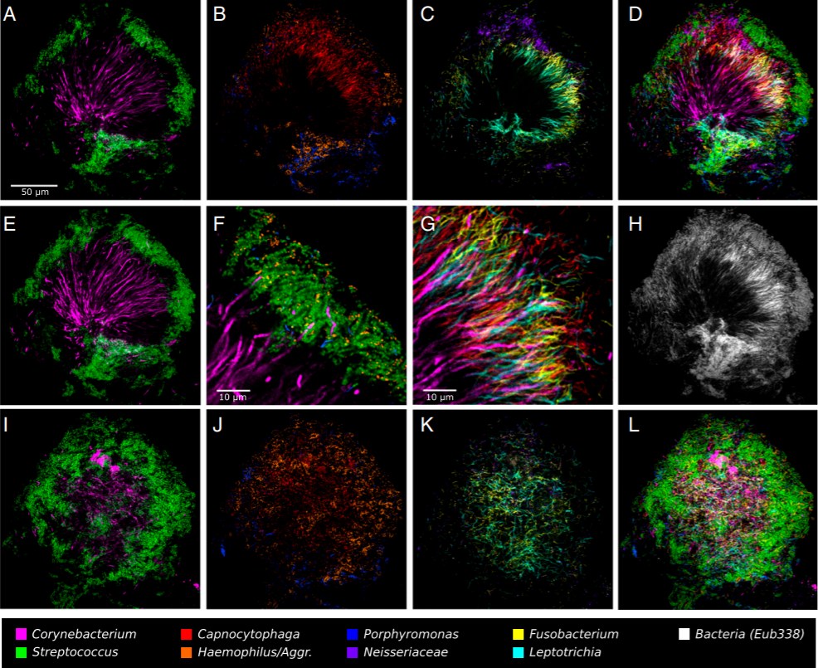
Tooth plaque microbiome – many microbes present
Welch et al.
Notes:
Nasal and oral microbes can secrete volatiles, in tooth we can smell these on our breath
These being present can be inhaled into our lungs and interact with the microbes present there

Slide 3
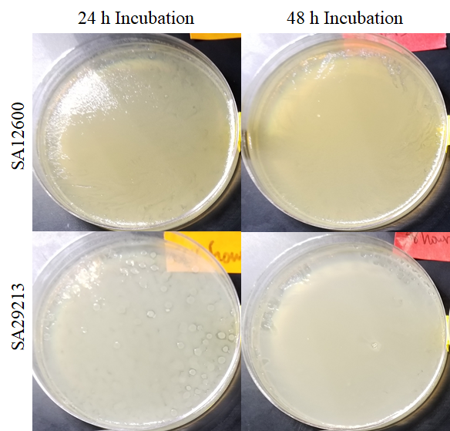
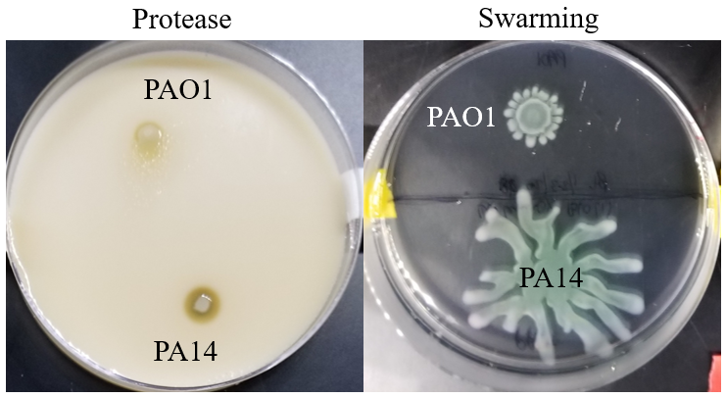
Goals & Hypotheses
To determine the impact of Staphylococcus aureus (SA) volatilomes on Pseudomonas aeruginosa (PA) phenotypes
SA VOCs will have an impact on PA swimming, swarming, twitching motility, protease production, and antibiotic resistance

Slide 4
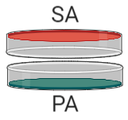
Volatilome Analysis Methods
Pre-grown SA Lawn
Day of PA phenotype inoculation

Slide 5
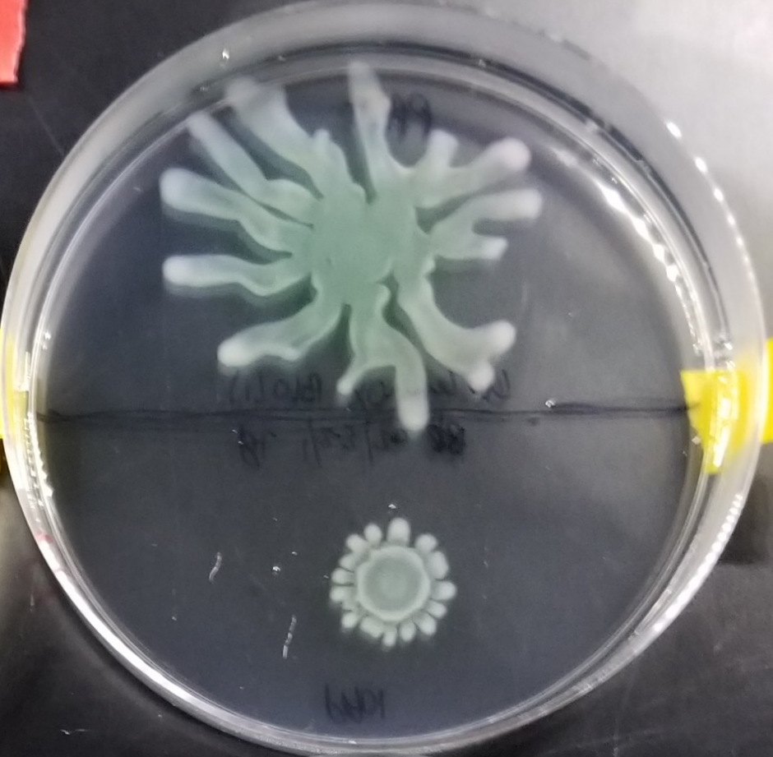
Swarming Methods
PA14
Radius
PAO1

Slide 6
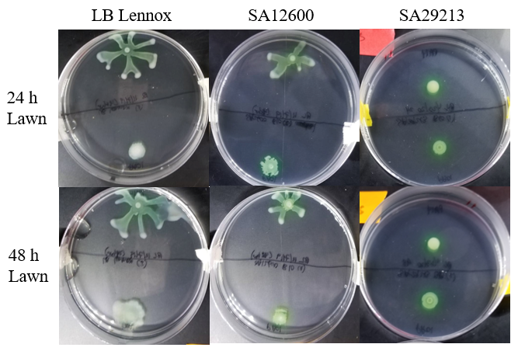
Swarming Plate Results

Slide 7
Swarming 48 SA lawns
*
*
*

Slide 8
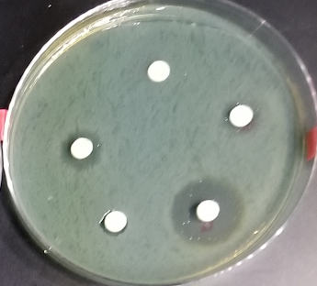
Antibiotic Disc measurement
PAO1 Lawn
Radius
0.3 cm

Slide 9
*
*
*
*
*

Slide 10
Summary of Results
PAO1 –
PA14 –
 | Protease | Swimming | Amikacin Treatment | Ciprofloxacin Treatment | Swarming | Twitching
SA12600 - 24 hours | No change | No change | No change | No change |  | No change
SA12600 - 48 hours |  | No change |  |  |  | No change
SA29213 – 24 hours |  | No change | No change
SA29213 – 48 hours |  | No change | No change

Slide 11
Conclusions
SA VOCs are able to affect PA swarming and twitching motility, protease production, and antibiotic resistance/susceptibility
These impacts are strain dependent
Notes:
SA can produce VOCs that influence PA phenotypes
It is a strain dependent manner
Swarming plate pictures
Not quorum level

Slide 12
Future Directions
Use this method to see if P. aeruginosa clinical isolates are affected by S. aureus volatiles
Determine if long-term exposure of S. aureus volatiles have any effect
Further investigate pigment difference in swarming assay
Linking VOC biomarkers to phenotype differences

Slide 13



Acknowledgements
Thanks to…
Bean Lab
Dr. Heather Bean, Trenton Davis, Carrie Jenkins, Ava Karanjia, Diana Ramirez
Notes:
Add logos of programs

Slide 14
References
Lemfack, M. C., Ravella, S. R., Lorenz, N., Kai, M., Jung, K., Schulz, S., & Piechulla, B. (2016). Novel volatiles of skin-borne bacteria inhibit the growth of Gram-positive bacteria and affect quorum-sensing controlled phenotypes of Gram-negative bacteria. Systematic and Applied Microbiology, 39(8), 503-515. doi:10.1016/j.syapm.2016.08.008
Palmer, Robert. “Faculty of 1000 Evaluation for Biogeography of a Human Oral Microbiome at the Micron Scale.” F1000 - Post-Publication Peer Review of the Biomedical Literature, 2016, doi:10.3410/f.726102480.793514043.

